Slide 1
A Presentation On LASER BASED SEISMOMETER
Presented BY-
AKANKSHA KHARE
AKANKSHA PATEL

Slide 2
SEISMOMETER
Seismometers are instruments that measures motions of the ground, including those of seismic waves generated by earthquakes ,volcanic eruptions , and other seismic sources.

Slide 3
BASIC PRINCIPLE OF SEISMOMETER
The basic principle of laser based seismometer is based on DOPPLER EFFECT
The relative moment of the inertia object and the immobile frame is measured by laser Doppler effect.

Slide 4
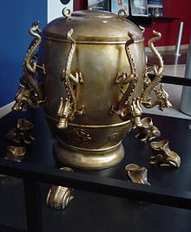
HISTORY OF ANCIENT SEISMOMETER
In AD 132, Zhang Heng of China’s Han dynasty invented the first seismoscope which was called Houfeng yi.

Slide 5
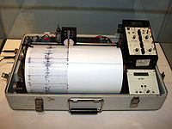
MODERN DESIGNS OF SEISMOGRAPH
Modern instruments use electronic sensors , amplifiers ,and recording devices .
Most are broadband covering a wide range of frequencies ,
500 – 0.00118 hz.

Slide 6
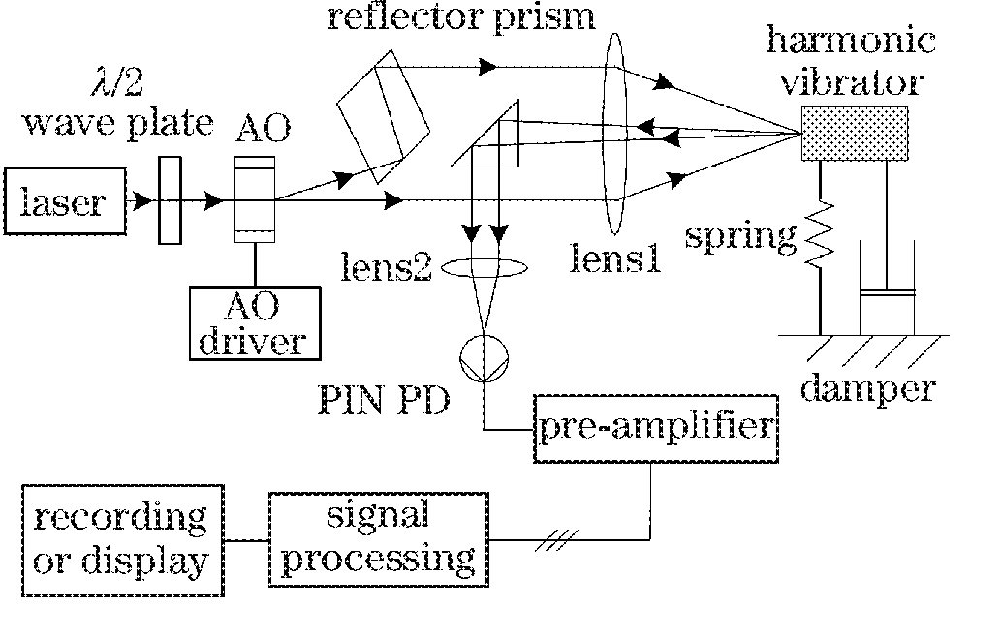
DESIGN OF SEISMOMTER

Slide 7
DESCRIPTION
It is the schematic diagram of seismic acquisition system based on laser doppler effect.
It comprises of laser sources, acousto –optic (AO) modulator ,lenses , and PD.
The doppler beat signals are picked up and transferred into current signals by the PD.
After pre-amplification ,they are transmitted to the signal processing unit where the signals are amplified ,filtered ,limited ,frequency modulated (FM) and frequency / velocity (F/V) transited.

Slide 8
RICHTER SCALE
RICTER MAGNITUDE
EARTHQUAKE EFFECTS
Less than 3.5
3.5-5.4
Under 6.0
6.1-6.9
7.0-7.9
8 or greater
Generally not felt ,but recorded
Often felt, rarely causes damage.
Major damage to poorly constructed buildings.
Can be destructive in areas up to about 100 km across area.
Major earthquake can causes serious damage over larger areas.
Great earthquake can cause serious damage in areas several hundred km across.

Slide 9
RANKS BASED ON OBSERVED EFFECTS
Earthquake type
Observed effects
Instrumental
Lightest
Mediocre
Strongly
violent
People do not feel any earth movement
Hanging objects swing back and forth.
The earthquake feels like a heavy truck hitting the walls
People have difficult standing . drivers feel their car shaking
Tree branches break . drivers have trouble steering.

Slide 10
HOW TO PREDICT AN EARTHQUAKE?????
It is not possible to predict an earthquake , because scientist do not know when stress will build up in a fault . Maybe in the future they can tell when earthquake will trigger.
Although seismograph are unable to predict at a specific time or date they are able to determine whether an earthquake is likely to affect a particular location over a particular length of time.
This is done by analyzing data.

Slide 11
HOW ARE EARTHQUAKES PREDICTED???
There are no accurate methods of predicting earthquakes , although scientists are now using data from seismographs , satellites and lasers to keep tally on the movements of seismic faults.
Predicting earthquakes is not an easy task nor an exact science as of today .
There has been some progress made in the prediction of earthquakes by observing the earth’s clues that the conditions are favorable for an earthquake.

Slide 12
HORIZONTAL SEISMOGRAPH
Horizontal seismograph consists of three parts :inertia member , the transducer , and the recorder.
The inertia member is a weight suspended by a wire or a spring. This is similar to a pendulum ; however , it can only swing in one direction.
The transducer can be a mechanical lever or an electrodynamic system .
In an electrodynamic system, a coil of wire moved back and forth in a magnetic field .
This movement created an electric current that passed through a galvanometer than recorded on a sheet of paper.

Slide 13
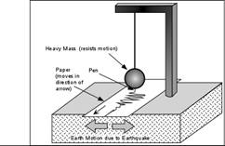
DESIGN
the design of seismograph is a weight freely suspended from a support that is attached to bedrock. When the seismic waves reached the seismograph , the inertia of the weight kept the device stable while the ground and support shake.

Slide 14
IMPROVEMENTS IN SEISMOLOGY
The performance of electromagnetic geophone has become the bottleneck of development of high resolution seismic acquisition .
Laser doppler techniques characteristics of high precision , five linearity , swift dynamic response , wide measuring range , and non – contiguity .
It has been widely used in diversified kinds of movements measurement.

Slide 15
APPLICATIONS OF SEISMOMETER
seismometer method provides most of the information for earthquake monitoring and prediction .
Seismic methods are sometimes used to locate sub surface water and to detect the underline structure of the oceanic and continental crust.
Seismology is concern with measuring the speeds seismic waves travel through the earth.

Slide 16
BASIC AND IMPORTANT FACT
Seismometer don’t predict earthquake , they only record them . In fact , nothing predicts earthquakes , at least with current technology.
seismometer are instruments that generally and basically depend on the motions of ground including those of seismic waves.

Slide 17
Video………….

Slide 18
THANK YOU
………………………………

